Slide 1
We Handle Claims and Manage Risk

Slide 2
Your Trusted Partner since 1946
80 years of excellence in claims and risk management
Started in 1945 by motor claims adjuster, Henri van Ameyde. Founded officially in 1946.
Key role in establishing the European Green Card system
Partnering with top insurers, brokers, and corporations in 30+ countries

Slide 3

From Then to Now
Then
Now
The pioneering of the Green Card system put Van Ameyde on the map. This was just the beginning of our core business, cross border claims, and our international expansion.
Our expertise and international reach provides the one-stop-shop that our clients need.
From claims handling to IT, marine surveying and all in between, Van Ameyde is the brand for all business lines throughout the entire claims process.

Slide 4
From Then to Now
Then
Now
Future
The pioneering of the Green Card system put Van Ameyde on the map. This was just the beginning of our core business, cross border claims, and our international expansion.
Our expertise and international reach provides the one-stop-shop that our clients need.
From claims handling to IT, marine surveying and all in between, Van Ameyde is the brand for all business lines throughout the entire claims process.
Tomorrow, we will be recognized as the expert of the entire claims process, offering unmatched AI-powered claims software.

Slide 5





From Then to Now
Then
Now
Future
The pioneering of the Green Card system put Van Ameyde on the map. This was just the beginning of our core business, cross border claims, and our international expansion.
Our expertise and international reach provides the one-stop-shop that our clients need.
From claims handling to IT, marine surveying and all in between, Van Ameyde is the brand for all business lines throughout the entire claims process.
Tomorrow, we will be recognized as the expert of the entire claims process, offering unmatched AI-powered claims software.
Certified
ISAE 3402
ISO 27001 certified
100% owned by
Committed to UN 10

Slide 6





Our Global Reach & Impact
Then
The pioneering of the Green Card system put Van Ameyde on the map. This was just the beginning of our core business, cross border claims, and our international expansion.
Now
Our expertise and international reach provides the one-stop-shop that our clients need.
From claims handling to IT, marine surveying and all in between, Van Ameyde is the brand for all business lines throughout the entire claims process.
Future
Tomorrow, we will be recognized as the expert of the entire claims process, offering unmatched AI-powered claims software.
Generating impact for insurance & risk management
185.000.000
1.500 +
46
33
1.000 +
Global revenue
Committed team members
Operating
companies
Countries
with own offices
Valued customers
Certified
ISAE 3402
ISO 27001 certified
100% owned by
Committed to UN 10

Slide 7
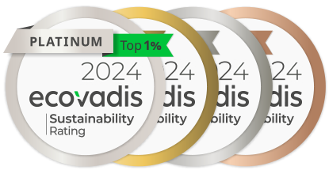




Sustainability
Together towards an environmentally responsible future
We have partnered with EcoVadis, a leading authority in sustainability assessments, to evaluate our policies, processes, and performance across four key pillars:
Social Responsibility
Corporate Governance
Sustainable Procurement
Environment

Slide 8
Our Capabilities
Deep local claims knowledge
A strong network across Europe
Claims platform ECHO®
Easy to integrate (ecosystems, platforms, portals, etc.)
Compliant with international and local regulatory requirements

Slide 9

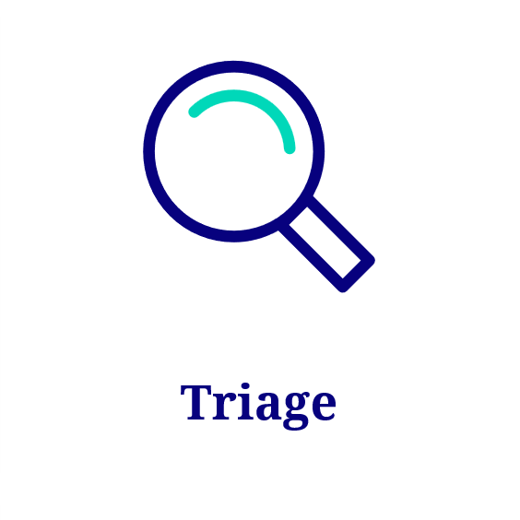
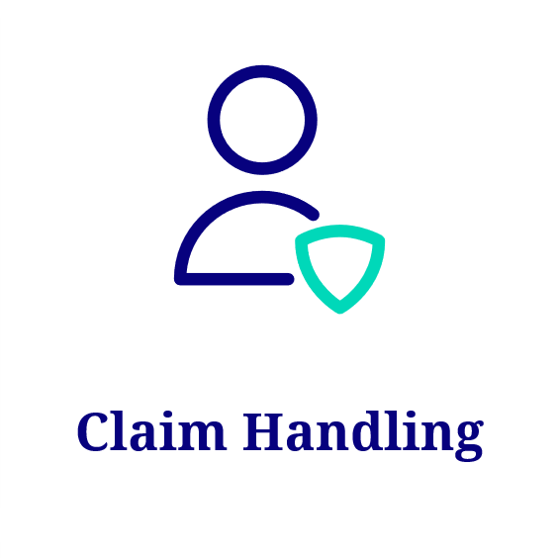


ECHO Claims Platform
Seamlessly connecting and uniting all international aspects of your operations
Multinational Support
Plug and Play
No-Code Setup
Self-Service Capabilities
Seamless Integration
Secure and Compliant

Slide 10
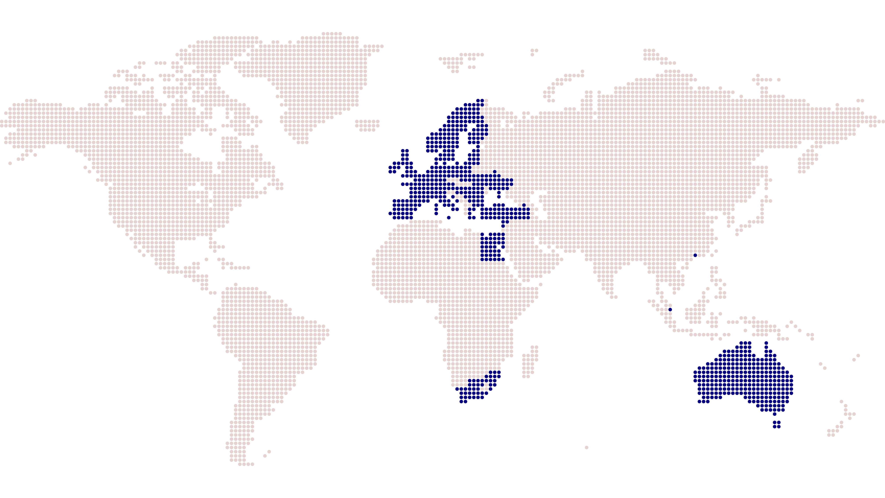



Worldwide Locations
Offices in Europe:
Austria
Belgium
Bulgaria
Croatia
Cyprus
Denmark
Estonia
Finland
France
Germany
Greece
Hungary
Ireland
Italy
Latvia
Lithuania
Luxembourg
Netherlands
Norway
Poland
Portugal
Romania
Spain
Sweden
Switzerland
Ukraine
UK
Europe
Turkey
Hong Kong
Egypt
Singapore
South-Africa
Australia
Human
Prioritize empathy and understanding
Personalized solutions
Commitment to care and respect
Strong client relations, exceptional support and effective outcomes
Innovative
Disrupt traditional methods with cutting-edge solutions
Stay ahead of industry trends
Entrepreneurial and creative culture
Enable clients to drive efficiency, streamline processes, and enhance their competitive edge
Results-Driven
Measurable outcomes
Real value for clients
Ambitious goals and high performance
Drive growth and success in competitive markets

Slide 11
Core Principles
Human
Innovative
Results-Driven
Prioritize empathy and understanding
Personalized solutions
Commitment to care and respect
Strong client relations, exceptional support and effective outcomes
Disrupt traditional methods with cutting-edge solutions
Stay ahead of industry trends
Entrepreneurial and creative culture
Enable clients to drive efficiency, streamline processes, and enhance their competitive edge
Measurable outcomes
Real value for clients
Ambitious goals and high performance
Drive growth and success in competitive markets

Slide 12

One-Stop-Shop
We are the dedicated claim handlers at the heart of your operations, providing your customers with the needed empathy and human intelligence

Slide 13
One-Stop-Shop
We are the dedicated claim handlers at the heart of your operations, providing your customers with the needed empathy and human intelligence
We are the software developers helping you modernize and optimize your current business, and prepare for the future

Slide 14
One-Stop-Shop
We are the dedicated claim handlers at the heart of your operations, providing your customers with the needed empathy and human intelligence
We are the software developers helping you modernize and optimize your current business, and prepare for the future
We are the on-the-ground surveyors and experts, tackling the most urgent challenges

Slide 15
We are specialists in:
Claims Software
Overflow Claims
Claims Management
Self-Insured & Captive
Interim Staffing
Fleet Management
Freedom of Services Representation
Property, Construction & Liability
Run-Off
Marine & Transport
Cross Border Motor Claims
Valuations
Risk Management
Loss Adjusting

Slide 16

Van Ameyde Group brands

Slide 17



















Van Ameyde Group brands

Slide 18




Why Van Ameyde?
Human & Tech
Symbiosis
Pioneers
Yin Yang:
Stable and Innovative
Couleur Locale

